Slide 1
CAPSTONE PROJECT
Wind & Solar Power Production Prediction
Presented By:
1.E.VISHWA-Alagappa college of technology,Chennai- CERAMIC DEPARTMENT

Slide 2
OUTLINE
Problem Statement
Proposed System/Solution
System Development Approach
Algorithm & Deployment
Result
Conclusion
Future Scope
References

Slide 3
PROBLEM STATEMENT
Problem statement: Analyze residential energy usage.
Objective: Identify factors affecting consumption and efficiency opportunities.
Scope: Explore correlations between consumption and variable.
Methodology: Collect, analyze, visualize data, and provide recommendations.
Outcome: Informed strategies for residential energy efficiency.

Slide 4
PROPOSED SOLUTION
This project aims to tackle the issue of understanding and optimizing residential energy consumption. By analyzing historical data, we seek to uncover patterns and trends in energy usage, shedding light on factors such as weather conditions, household demographics, and appliance usage that influence consumption. Leveraging advanced analytical techniques, including statistical analysis and machine learning, we will delve into the correlations between these variables and energy usage patterns. Through insightful visualization and interpretation of the findings, we will offer actionable recommendations for promoting energy efficiency in residential communities. Ultimately, this endeavor aims to empower stakeholders with the knowledge needed to implement targeted interventions and policy measures that enhance sustainability and affordability in the residential energy sector.

Slide 5
SYSTEM APPROACH
Building the proposed solution would involve a combination of data processing, feature engineering, and machine learning. Here are the key system and library requirements:
System Requirements:
Hardware:
A computer with sufficient processing power, preferably with multiple cores or a GPU for faster training of machine learning models.- Adequate RAM to handle the size of the dataset and computational requirements.
Software:-
An operating system compatible with the required machine learning libraries (e.g., Windows, Linux, macOS).

Slide 6
Library Requirements:
1.Data Processing and Analysis:-
Pandas: For data manipulation and analysis
NumPy: For numerical operations on data.
2. Data Visualization:-
Matplotlib and Seaborn: For creating visualizations to understand data patterns.
Plotly or Bokeh: Interactive visualization libraries for more complex visualizations.

Slide 7
ALGORITHM & DEPLOYMENT
Algorithm:
Sure, here's a brief overview:
1.Data Collection: Gather historical weather and power production data.
2. Preprocessing: Clean and normalize the data.
3. Feature Engineering: Extract relevant features.
4. Model Selection: Choose suitable machine learning models.
5. Training: Train the selected models using historical data.
6. Evaluation: Assess model performance using metrics.
7. Deployment: Deploy the trained model for real-time predictions.
8. Monitoring and Maintenance: Continuously monitor and update the model as needed.
.

Slide 8
Deployment Statement:
Deployment involves setting up the predictive model to make real-time predictions accessible to users. This can be done through:
1.Web Service/API: Create a web service or API where users can input current weather conditions, and the model returns predicted power production values for a specific time frame.
2. Integration with Existing Systems: Integrate the predictive model into existing energy management systems or renewable energy infrastructure to provide real-time insights and optimize operations.
3. Cloud Deployment: Host the model on a cloud platform like AWS, Azure, or Google Cloud for scalability and accessibility.
4. Edge Deployment: Deploy the model directly on edge devices, such as IoT sensors or smart meters, to enable localized predictions without relying on external servers.
5 User Interface: Develop a user-friendly interface for accessing predictions, visualizing results, and adjusting parameters if necessary.
6. Security and Compliance: Ensure that the deployment adheres to security standards and regulatory requirements, especially when dealing with sensitive data like energy production and consumption.
7. Scalability and Performance: Design the deployment architecture to handle varying levels of demand and ensure optimal performance under different load conditions.
Overall, the deployment process aims to make the predictive model readily available and usable by stakeholders involved in managing wind and solar power production.

Slide 9
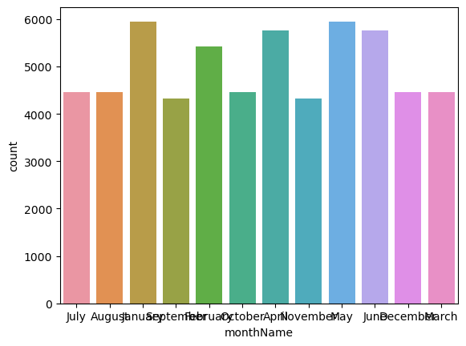
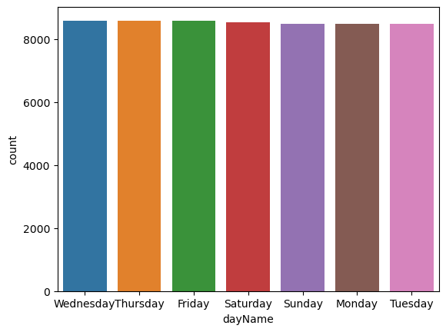
RESULT

Slide 10
CONCLUSION
In conclusion, this project addresses the critical need to understand and optimize residential energy consumption. Through comprehensive analysis of historical data and advanced analytical techniques, we have identified key factors influencing energy usage patterns. By uncovering these insights, we can now provide actionable recommendations for promoting energy efficiency in residential communities. Armed with this knowledge, stakeholders can implement targeted interventions and policy measures to enhance sustainability and affordability in the residential energy sector. Overall, this project represents a significant step towards achieving our goal of fostering a more efficient and sustainable energy future for all.

Slide 11
FUTURE SCOPE
The future scope of this project includes real-time monitoring systems, renewable energy integration analysis, personalized intervention strategies, smart grid integration, longitudinal studies, policy analysis, and cross-disciplinary collaboration, aiming to further enhance energy efficiency and sustainability in residential communities.

Slide 12
REFERENCES
https://www.kaggle.com
https://colab.research.google.com/?utm_source=scs-index

Slide 13
THANK YOU

